Slide 1


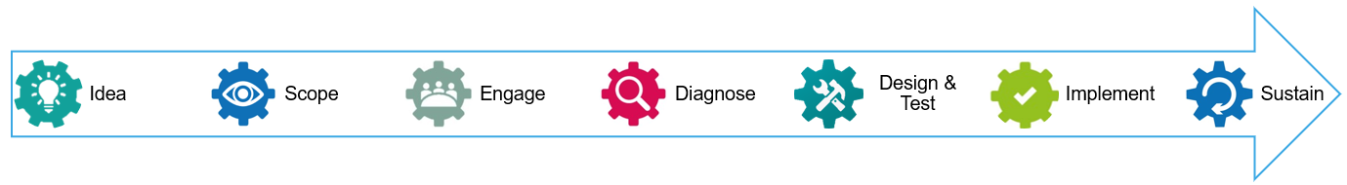



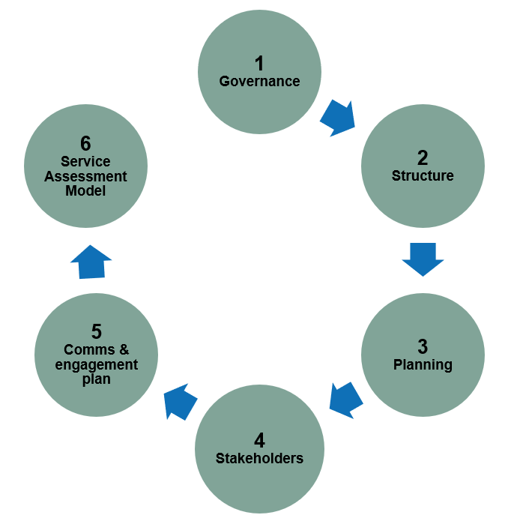

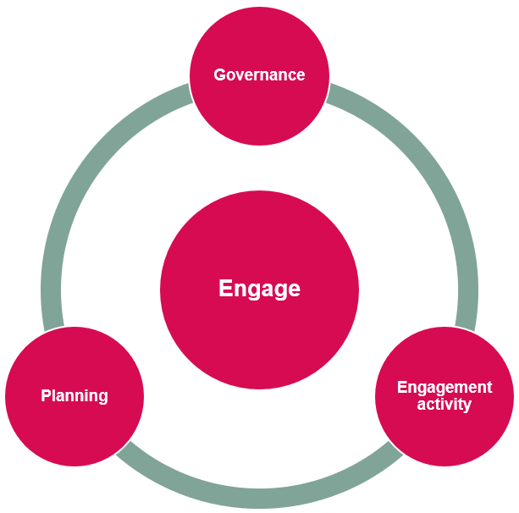

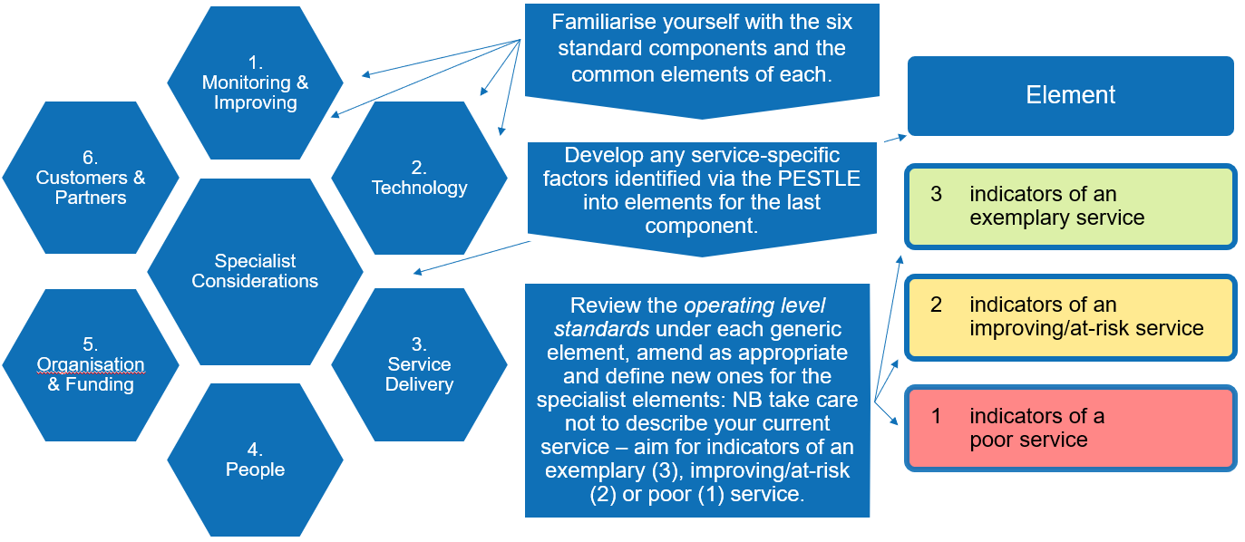










    Service Review Guide
    for departments and faculties
Service review methodology
Idea
Service reviews provide a structured, proactive and comprehensive approach to understanding and improving all aspects of our services and adapting them to stakeholders’ changing needs.
The methodology consists of a series of stages to work through in turn.
What service will be reviewed?
Who are the service providers?
What are the review’s aims?
Who will advocate for the review?
Scope
Develop and document the scope and approach for the service review, seek input from relevant parties and gain the agreement you need to proceed. The scope stage has multiple steps.
Structure
Produce a charter with
Objectives and expected benefits
Timeframe and deliverables
Success factors
Stakeholders and project team members
Planning
Data - how to collect, how long will it take, who owns it?
Working arrangements with sponsor and stakeholders, how to update and gain input, how often to meet
Governance
Convene an oversight group
Include service providers, users, resource allocators and the sponsor as chair
Set clear lines of responsibility to existing governance
Ensure members have relevant knowledge, time and a commitment to see improvements
Stakeholders
Develop a stakeholder map to identify your stakeholders
Prepare a communications and engagement plan for each group
Communications & engagement plan
Define approaches for each stakeholder type
What do you need to achieve?
What do you want them to know?
How are you going to reach them?
Service Assessment Model (SAM)
Engage
A structure for understanding current levels of provision and developing an improvement plan for an optimally designed service.
Secure oversight group approval for any updates to plans
Implement comms and engagement plan
Define how the SAM will be used
Develop approach to gathering and recording data and evidence
Diagnose
Design and Test
Understand stakeholder perceptions and the current state of service operations and to gather improvement ideas.
Work with stakeholders to design and test new approaches.
Engagement – in line with communications and engagement plan
Planning – structure of Diagnose report, format of Oversight Board workshop and diary time required for next phase
Data – gather and record data
Reporting – draft Diagnose report with feedback between iterations
Governance – present Diagnose report to Oversight Group
Engagement – work with key stakeholders to further develop ideas
Planning – confirm governance timetable for implementing recommendations and plan report Oversight Board consultation
Reporting – draft Design & Test report with feedback between iterations
Governance – Oversight Group to consider and confirm recommendations and high level implementation plan
SAM – develop prototype models of future arrangements for discussion
Implement
Sustain
Implement new working practices, ensuring all stakeholders are informed and equipped to adapt to and adopt the changes.
Ensure new working practices are embedded into business as usual, together with adopting CI approaches, culture and mindset.
Plan benefits monitoring and KPIs
Keep your stakeholders engaged
Hold an After Action Review to refine approach for future reviews and to draw out lessons learned
Use the SAM baseline to identify priority areas and flesh out the high-level implementation plan
Document filing and archiving – apply 6S and safeguard knowledge
Monitor and evaluate progress – use SOPs and process confirmation
End of project reporting – highlight approach and outcomes to key audiences
Use CI tools – daily updates, keep in touch, opportunity logs
Are you looking for a structured approach to improve the delivery of your services?
This scaled-down version of the cross-University service review methodology provides a proactive and comprehensive way to ensure service delivery meets stakeholder needs.
Find out more by visiting the Service Review Guide webpage on the Focus website.

